Slide 1

About Edunet
We are Victorian Owned and Operated for 15 years
We operate our own Service Centre in South Eastern Victoria
We provide technical support services to 40 Schools/Colleges
We supply hardware to over 600 schools
Lenovo DEECD Authorised Panel Supplier
Authorised Apple Education Reseller
Focused primarily on the Victorian Education sector.

Slide 2

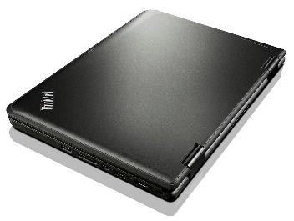
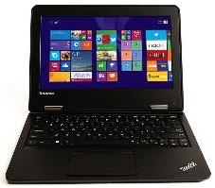

Device Options – 11e (Non Touch)
^{SPECIFICATIONS}
Intel® Celeron™ N2940 Quad Core processor
^{Windows 8.1 (64 bit)}
^{4GB RAM}
^{128GB Solid State Drive}
11.6” HD LED Anti-Glare display
^{Screen flips 360 degrees}
Bluetooth, Camera and 4-in-1 card reader
^{Wireless-N 7260 a/b/g/n}
^{1 Year Return to Base Warranty}
$636.73
Inc. GST
$764.15
Ex. GST

Slide 3
Options for 11e Clamshell
3 Year Onsite and 3 Year Sealed Battery Warranty | $184.19
iBroker Accidental Damage, Theft and Loss Insurance ($50 excess) | $165.00
Targus TANC Case | $64.41
Targus Contego Case | $43.34
Lenovo Work In Case | $38.50

Slide 4
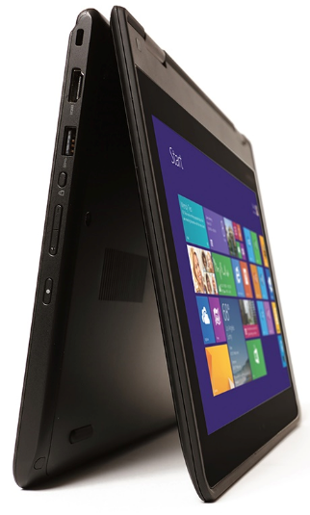
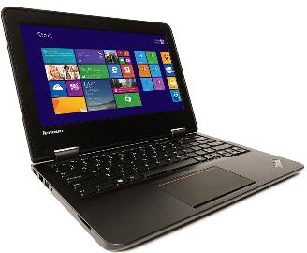
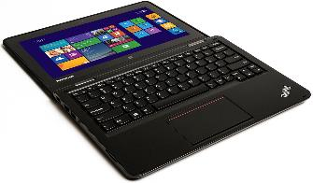

Device Options – Yoga 11e
^{SPECIFICATIONS}
Intel® Celeron™ N2940 Quad Core processor
^{Windows 10 (64 bit)}
^{4GB RAM}
^{128GB Solid State Drive}
11.6” HD IPS Gorilla glass multi-touch display
^{Screen flips 360 degrees}
Bluetooth, Camera and 4-in-1 card reader
^{Intel® HD Graphics}
^{Wireless-N 7260 a/b/g/n}
^{1 Year Return to Base Warranty}
$732.22
Inc. GST

Slide 5
Options for 11e Yoga
3 Year Onsite and 3 Year Sealed Battery Warranty | $184.19
iBroker Accidental Damage, Theft and Loss Insurance ($50 excess) | $165.00
Targus TANC Case | $64.41
Targus Contego Case | $43.34
Lenovo Work In Case | $38.50

Slide 6

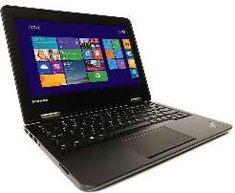
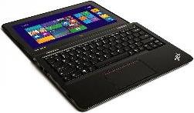
Device Options – Yoga 11e with Active Pen
^{SPECIFICATIONS}
^{Intel® Core™ M-5y10 processor}
^{Windows 10} ^{(64 bit)}
^{4GB RAM 1333MHz DDR3L on board}
^{192GB Solid State Drive}
11.6” HD IPS Gorilla glass multi-touch display
^{Active Pen}
^{Screen flips 360 degrees}
Bluetooth, Camera and 4-in-1 card reader
^{Intel® HD Graphics}
^{Wireless-N 7260 a/b/g/n}
^{1 Year Return to Base Warranty}
$1,008.54
Inc. GST

Slide 7
Options for 11e Yoga
3 Year Onsite and 3 Year Sealed Battery Warranty | $184.19
iBroker Accidental Damage, Theft and Loss Insurance ($100 excess) | $264.00
Targus TANC Case | $64.41
Targus Contego Case | $43.34
Lenovo Work In Case | $38.50

Slide 8
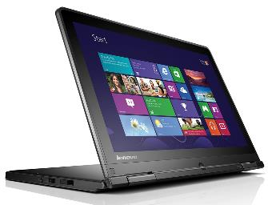
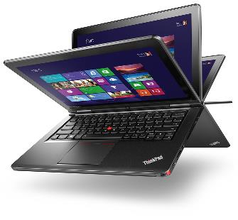
Device Options – 12.5 Yoga
^{SPECIFICATIONS}
Intel® Core™ i3-5005U processor
^{Windows 10 (64 bit)}
^{4GB RAM}
^{128GB Solid State Drive}
^{12.5” FHD multi-touch display}
^{Screen flips 360 degrees}
Digitiser Pen, Bluetooth, Camera and 4-in-1 card reader
^{Intel® HD Graphics}
^{Wireless-N 7260 a/b/g/n}
^{3 Year Return to Base Warranty}
$1,473.51
Inc. GST

Slide 9
Options for 12.5 Yoga
Targus Orbus Hardsided Laptop Case | $53.35
Targus Contego Armoured Slipcase Laptop Bag | $46.64
Targus TANC Case | $76.12
3 Year Onsite and 3 Year Sealed Battery Warranty | $87.56
iBroker Accidental Damage, Theft and Loss Insurance ($100 excess) | $264.00

Slide 10
Device Options – Apple Macbook Air 11.6”
^{SPECIFICATIONS}
Intel® Core™ i5 processor OS X 10.9 Mavericks
4GB RAM
128GB Solid State Storage
11.6" HD Display
Bluetooth and Camera
Wireless a/b/g/n 802.11
1 Year Limited Warranty
$1,174.64
Inc. GST

Slide 11
Options for Macbook Air
AppleCare Protection Plan for Macbook Air | $222.09
iBroker 3 Year Loss / Theft / Damage Insurance ($100 excess) | $264.00
Targus 11.6” Contego Armoured Slipcase | $43.34
Targus 11.6” Orbus Hardsided Laptop Case | $51.64

Slide 12
Device Options – Apple Macbook Air 13.3”
^{SPECIFICATIONS}
Intel® Core™ i5 processor OS X 10.9 Mavericks
4GB RAM
128GB Solid State Storage
13.3" HD Display
Bluetooth and Camera
Wireless a/b/g/n 802.11
1 Year Limited Warranty
$1,316.70
Inc. GST

Slide 13
Options for Macbook Air
AppleCare Protection Plan for Macbook Air | $222.09
iBroker 3 Year Loss / Theft / Damage Insurance ($100 excess) | $264.00
Targus Orbus Hardsided Laptop Case | $53.35
Targus Contego Armoured Slipcase Laptop Bag | $46.64
Targus TANC Case | $76.12

Slide 14
Device Options – Apple Macbook Pro 13.3”
^{SPECIFICATIONS}
Intel® Core™ i5 processor
OS X 10.9 Mavericks
4GB RAM
500GB Hard Disk Drive
13.3" HD display
Bluetooth and Camera
Wireless a/b/g/n 802.11
$1,457.61 Inc. GST

Slide 15
Options for Macbook Pro
AppleCare Protection Plan for Macbook Air | $222.09
iBroker 3 Year Loss / Theft / Damage Insurance ($100 excess) | $264.00
Targus Orbus Hardsided Laptop Case | $53.35
Targus Contego Armoured Slipcase Laptop Bag | $46.64
Targus TANC Case | $76.12

Slide 16

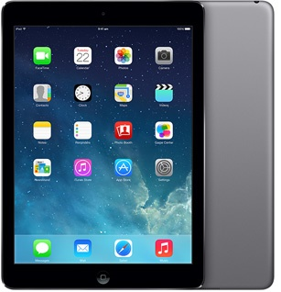
Device Options – Apple iPad Air
^{SPECIFICATIONS}
A7 chip with 64-bit architecture and M& motion coprocessor
^{iOS 7 and iCloud}
^{32GB Storage}
2048 by 1536 resolution at 264 pixels per inch
9.7 inch LED Backlit Multi Touch IPS Display
^{Weighs 469g}
Bluetooth and FaceTime HD Camera and 5MP iSight camera with 1080p HD video recording
Wi-Fi 802.11a/b/g/n dual channel and MIMO
$566.28
Inc. GST

Slide 17
Options for iPad Air
AppleCare Protection Plan for iPad | $102.30
iBroker 3 Year Loss / Theft / Damage Insurance ($100 excess) | $214.50
Versavu Slim Case for iPad Air | $44.55

Slide 18


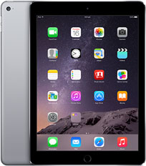
Device Options – Apple iPad Air 2
^{SPECIFICATIONS}
A8X chip with 64-bit architecture and M8 motion coprocessor
^{iOS 8 and iCloud}
^{64GB Storage}
2048 by 1536 resolution at 264 pixels per inch
9.7 inch LED Backlit Multi Touch IPS Display
^{Weighs 437g}
Bluetooth and FaceTime HD Camera and 5MP iSight camera with 1080p HD video recording
Wi-Fi 802.11a/b/g/n dual channel and MIMO
$745.58
Inc. GST

Slide 19
Options for iPad Air 2
AppleCare Protection Plan for iPad | $102.30
iBroker 3 Year Loss / Theft / Damage Insurance ($100 excess) | $214.50
Versavu Slim Case for iPad Air | $44.55

Slide 20

iBroker Insurance
What is Covered?
Accidental Loss – For Example
    Left on Public Transport
    Left at Bus Stop
Accidental Damage – For Example
    Dropped
    Stepped On
    Driven Over
    Pulled Off Desk
    Fell out of Locker
    Liquid Spill
Loss or damage by theft or attempted theft
From unoccupied building or vehicle only following forcible entry
In the open air only where:
    Laptop in direct supervision and control of adult
    At their place of education
    At school organised activity / event
    At organised extra curricular activity
    Other places of residence
    Medical appointments of any kind
    By force or intimidation
What isn’t Covered?
Electrical or mechanical malfunction or derangement
Scratches and normal wear and tear
Malicious damage by your child
Loss or damage by theft or attempted theft:
  From an unoccupied building or vehicle unless as a result of forcible entry
  From any unsecured place in the open air unless:
    The laptop is under the direct control and supervision of an adult; or
    Your child is on the way to or from their place of education; or
      An organised school or educational activity; or
      An organised extra-curricular activity; or
      Other places of residence of accommodation; or
      A medical appointment of any kind
  Loss of damage occurring while the laptop is being transported in any aircraft or watercraft unless the laptop is carrier as personal baggage
  Loss of or damage to software of any sort

Slide 21
Support Process
Student Visits
School Techs
Technical Assessment
Software Related Issue
Hardware Failure
(Warranty)
Loss / Theft / Damage
Repair / Re-Image / Return
Warranty Job Logged
Begin Claim Process

Slide 22
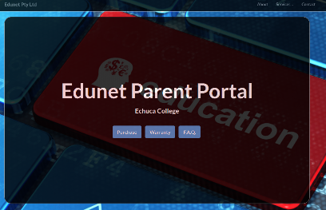
Ordering
Visit the Edunet Parent Portal at:
echucacollege.technologyportal.com.au
Password: Echuca2016
Follow ordering process to:
  Select model and options
  Enter family details
  Accept IT USE Policy
  Select Payment Method

Slide 23
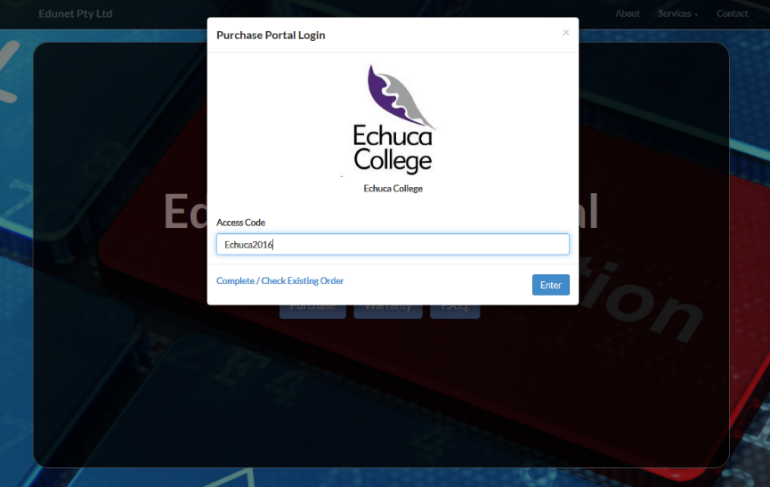
Secure Login

Slide 24
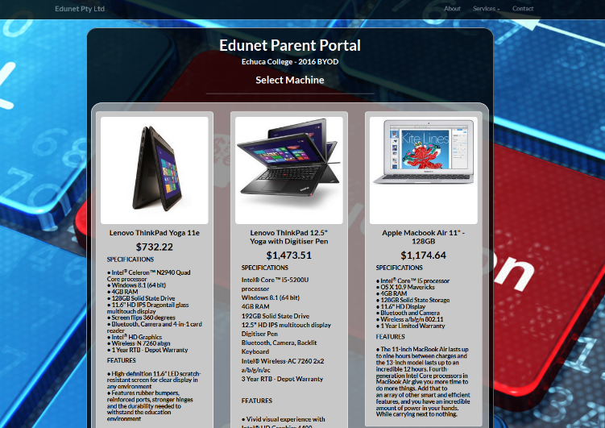
Device Selection

Slide 25
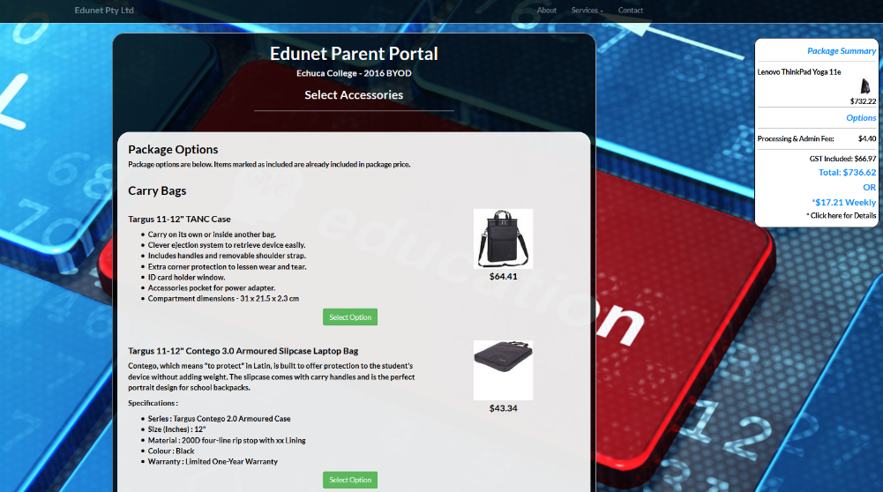
Options Selection

Slide 26
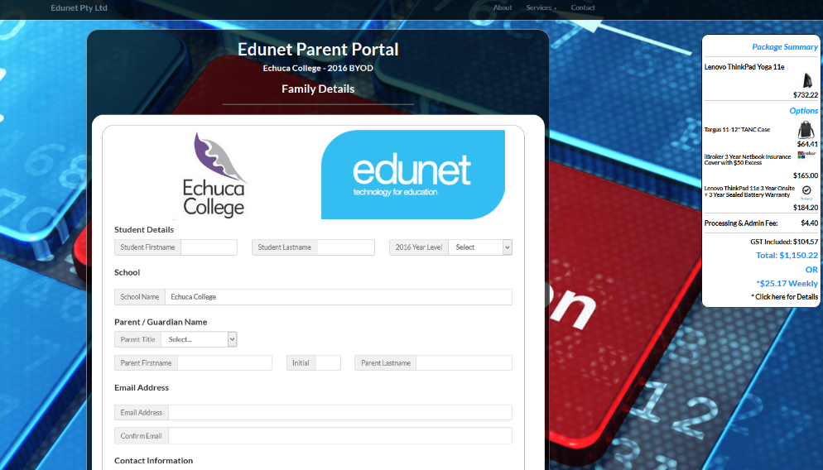
Family Details

Slide 27
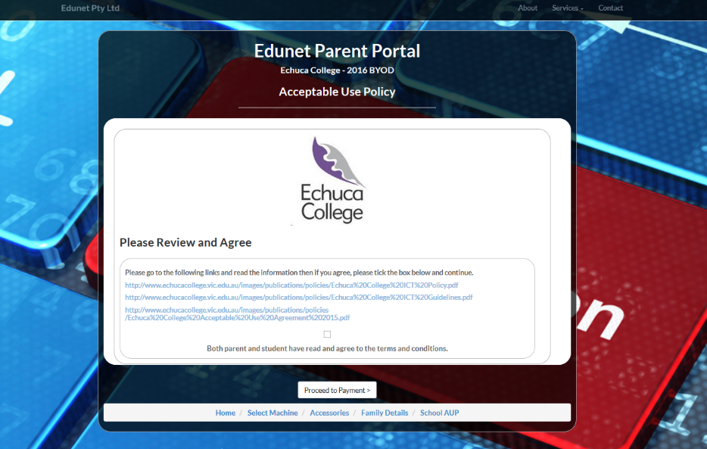
Acceptable Use Policy

Slide 28
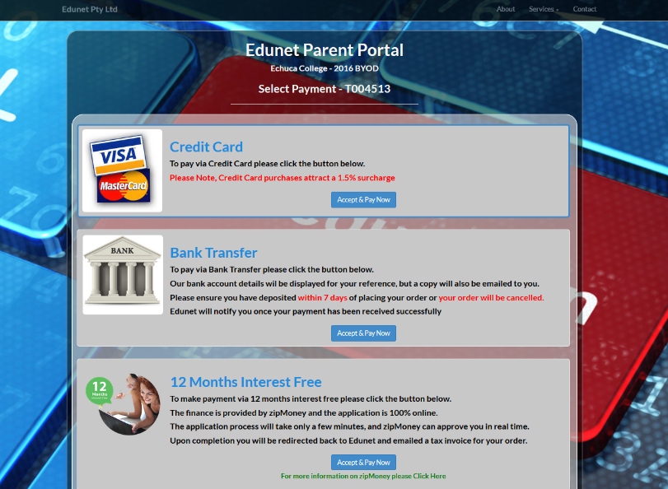
Payment Details

Slide 29

zipMoney
Online process completed when you place an order
12 months interest free finance plan
No deposit required
One off establishment fee of $99
Account Fee of $4.95 per month whilst there is a balance owing
Must pay the weekly payment we give you when you order to pay it off within the interest free period
To qualify you must:
Be over 18 years of age
Be an Australian Resident
Employed in some capacity
Earn more than $300 per week
Each application assessed individually

Slide 30
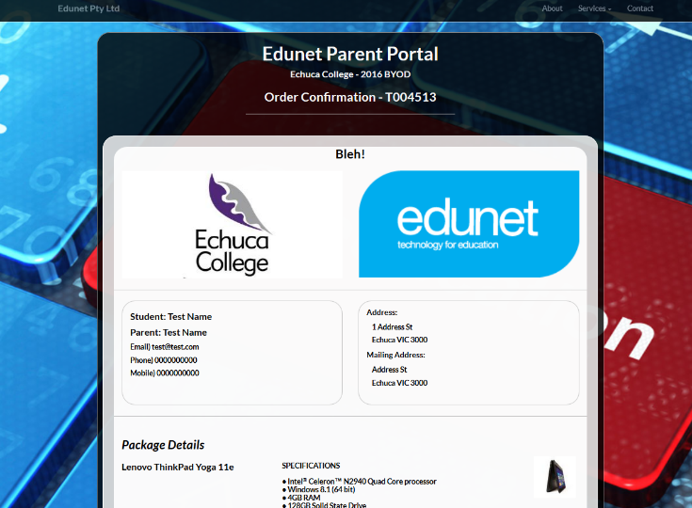
Order Confirmation

Slide 31

Thank You!
03 9708 8700
portal@edunet.com.au
www.edunet.com.au
Unit 1, 12-13 Trewhitt Court, Dromana VIC

